Slide 1
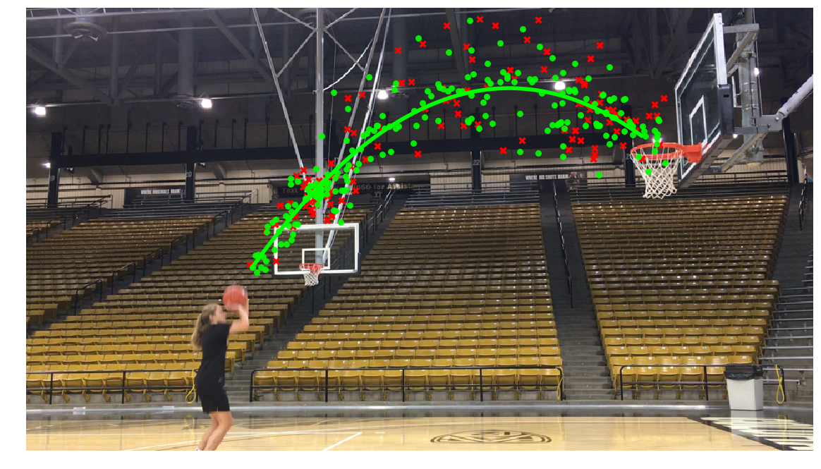
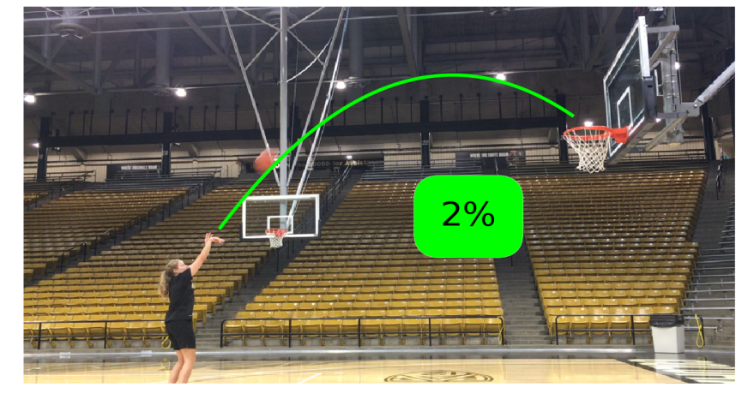
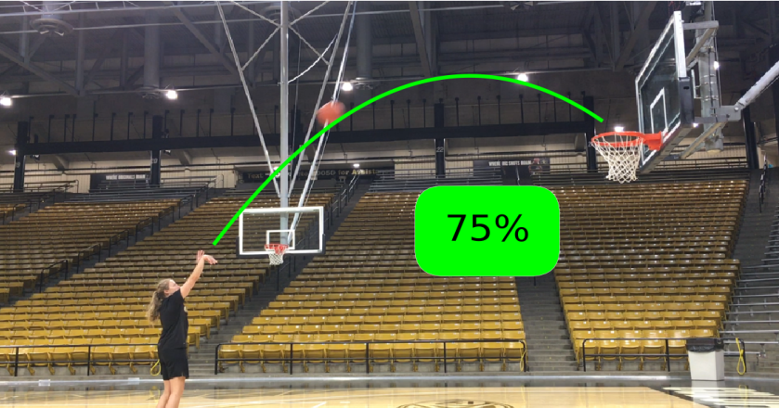
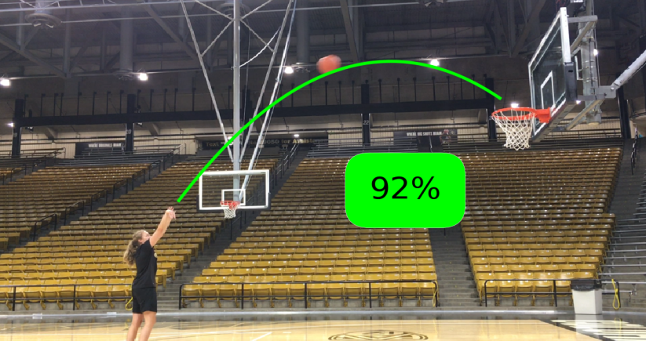
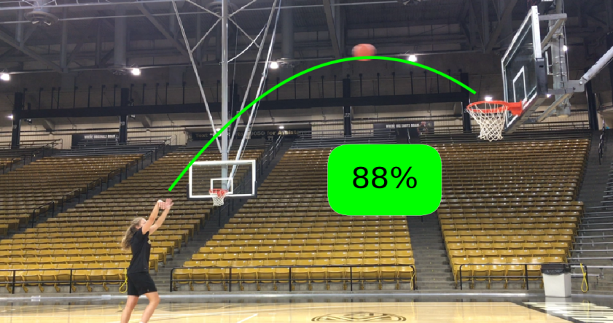
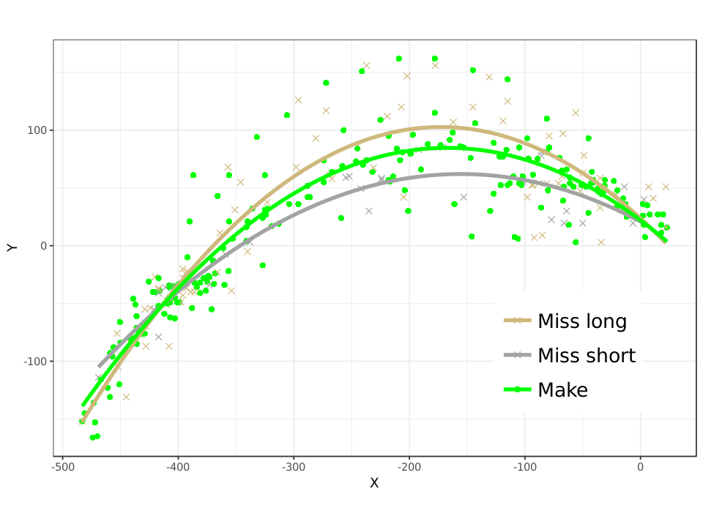
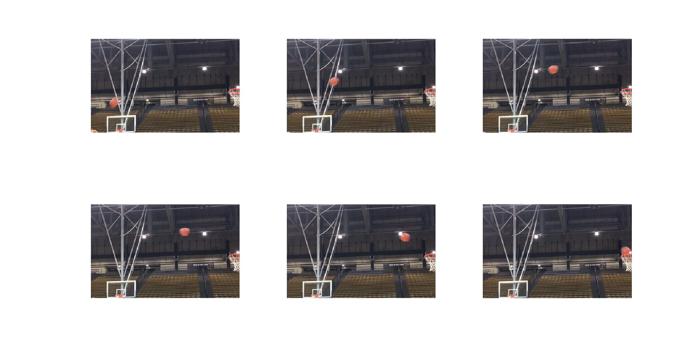
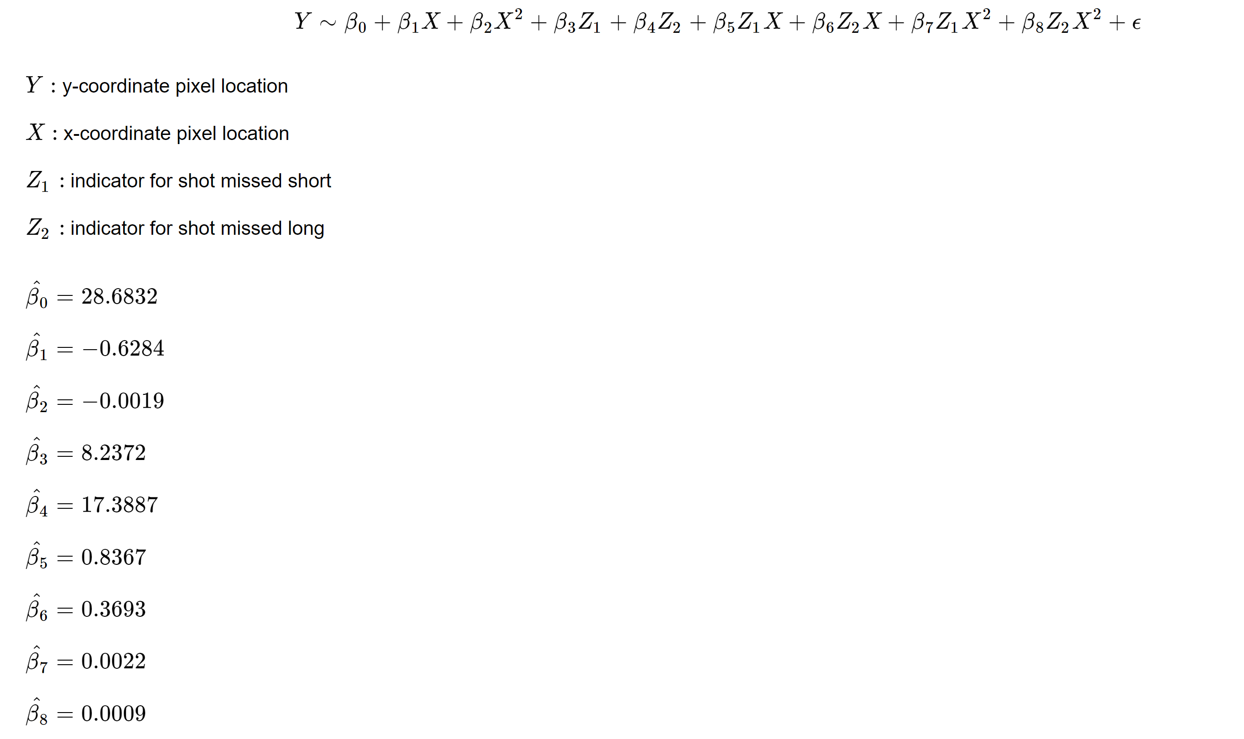
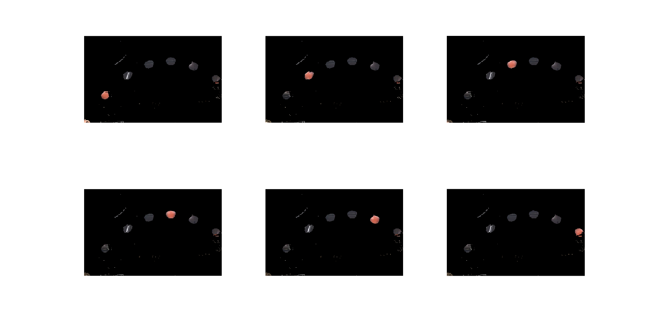
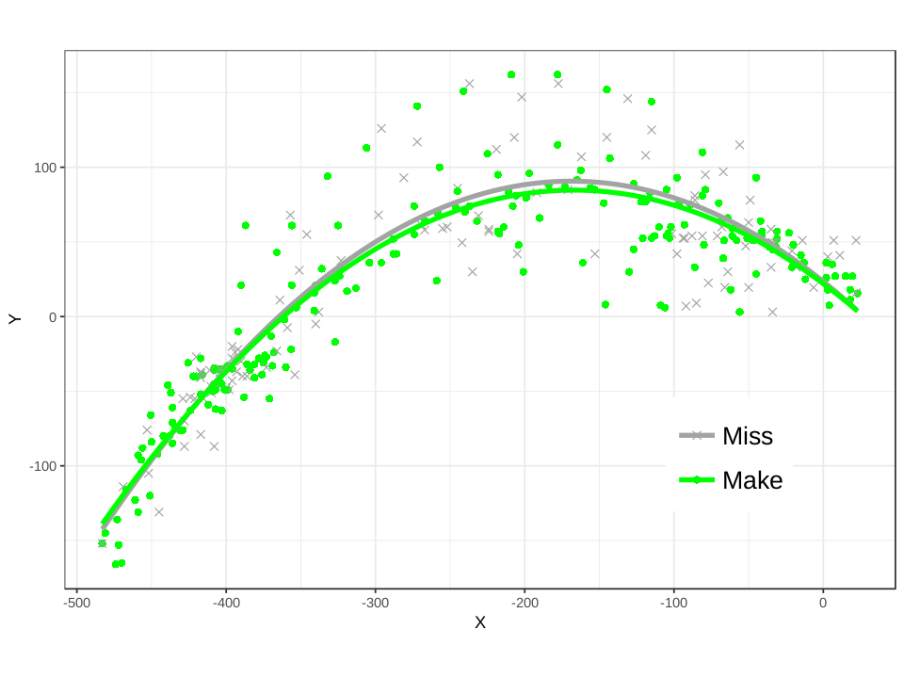
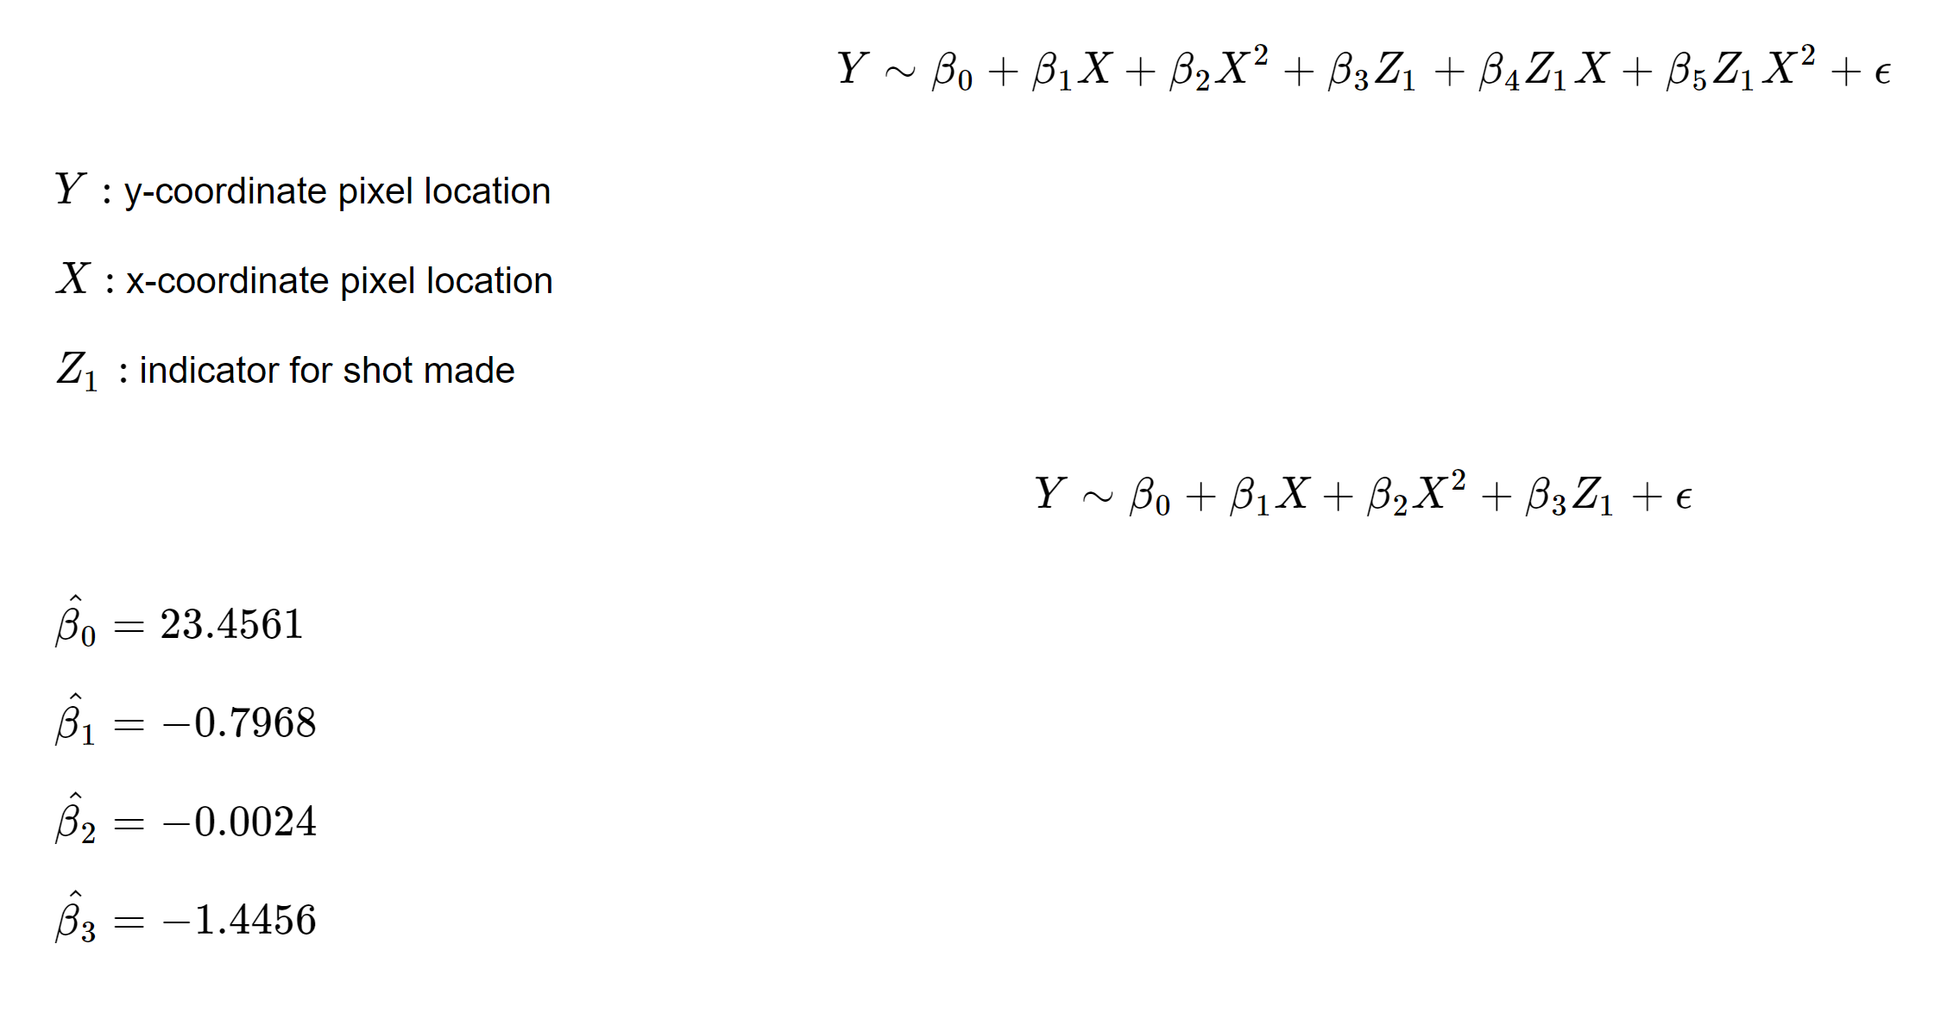
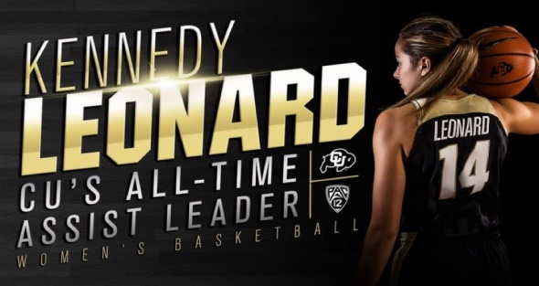
Computer Vision Based Analysis of Kennedy Leonard’s Jump Shot
Scott Baker
Dr. Brian Zaharatos, Department of Applied Mathematics
Introduction
Prediction
A common question for basketball players is
how good is my shot?
This project attempts to answer this question for Kennedy Leonard [1], Colorado’s all-time assists leader in Women’s Basketball. Using techniques from computer vision and data science, the goal of this project is to accurately model the differences between Leonard’s made and missed shots. Collecting tracking data involves a modified k-means segmentation algorithm [2]. Analysis of the tracking data uses polynomial regression.
One application of this model is to predict Leonard’s mid-shot shooting percentage based on previous data [1].
Computer Vision
A visualization of Leonard’s made and missed shots
Remarks
The first stage in collection involved taking 41 videos of Leonard shooting the basketball. These videos were broken down into frames and processed using a k-means segmentation with two steps. First, a motion-based filter is applied to “zoom in” on the ball.
Models
A generalized least-squares polynomial regression [3] model with weighting to account for non-constant variance was fit using ball locations from segmentation and the classifications ‘make’, ‘miss short’, and ‘miss long’:
Two critical elements of this process:
Accuracy adjustment based on k-means diagnostics to identify outliers
Identification of the basketball hoop pixel-location for each video in order to transform data into relative location
Sources of error:
Deterministic nature of modified k-means algorithm
Slight camera movements over the sequence of frames
References
Second, the clustering is oriented towards the color of the ball:
[1] “Kennedy Leonard.” University of Colorado Athletics, cubuffs.com/roster.aspx?rp_id=11879.
[2] Forsyth, David A., and Jean Ponce. Computer Vision: A Modern Approach. 2nd ed., Pearson Education, 2015.
[3] Faraway, Julian James. Linear Models with R. Chapman & Hall/CRC, 2015.
This model had all significant terms. However,
a model using ball locations and a single tag as ‘make’ or ‘miss’ resulted in insignificant classification and interaction terms:
Acknowledgements
Kennedy Leonard for helping us obtain high quality input video
Tristan Neate for his contributions to the computer vision algorithms
Elliott Tung for his basketball advice with respect to explanation
The highest scoring cluster center coordinate locations were recorded for 5-8 frames per video.

